Slide 1

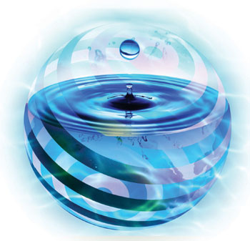




Lake Modeling
Stagnant Lake, Flowing Lake
Simple Model at Steady State

Slide 2





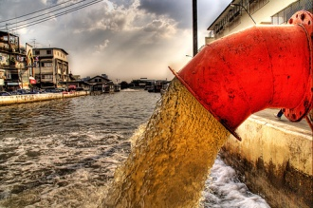
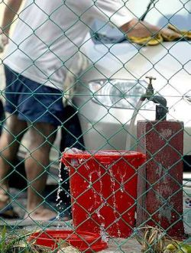
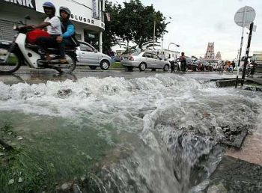
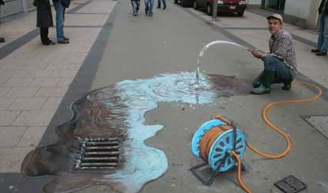

2.1 Water Quality Modeling
Water is a natural resource vital for survival;
Human beings who need water in daily lives;
Increasingly becoming scarce due to reduced quantity and declined quality;
↑ demand and ↑ wastage + climate change ⇒ decreasing water sources.

Slide 3
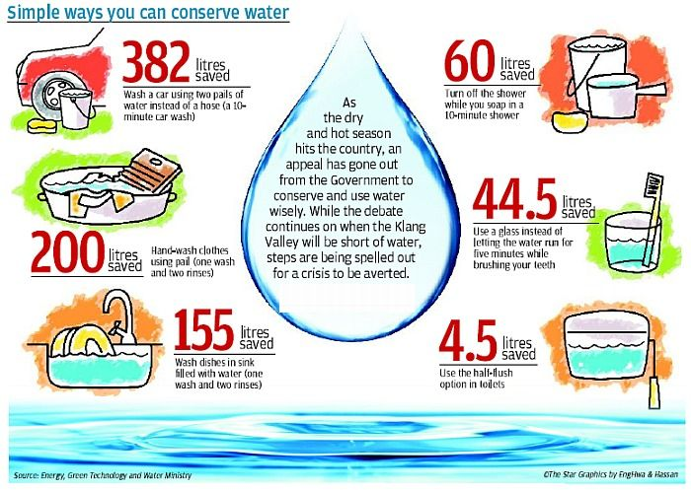
Simple Ways to Conserve H₂O
NST
April 5, 2017
Penangites urged to reduce water usage, taps could run dry in the future

Slide 4
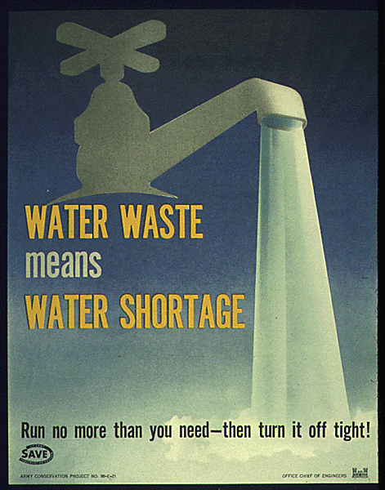

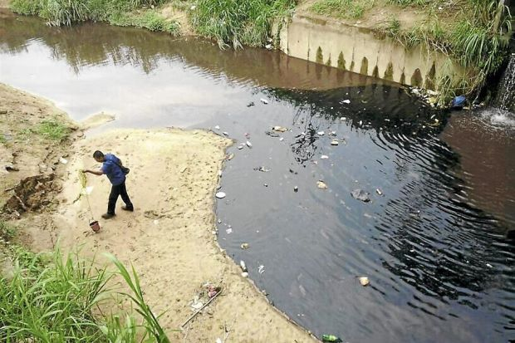
Water Waste = Water Shortage
The recent oil spillage at Sungai Selangor which resulted in a major water disruption in the Klang Valley has shown just how vulnerable and exposed our water sources are.
Tuesday March 22, 2011
Malaysia faces looming water crisis
Malaysia = 226 L per person per day.
Singapore = 154 L per person per day.
Thailand = 90 L per person per day.
Malaysian recommended daily limit
= 165 L per person per day.
Tuesday July 3, 2012
Save water now, people told
Monday June 18, 2012
Water crisis looms in Selangor
Monday June 18, 2012
Time to stop taking water for granted

Slide 5
World Water Prices (Source: International Water Resources Association, Vol. 1, No. 3, 2001)
Country | Price of water per m³ (US$) | Country | Price of water per m³ (US$)
Germany | 1.78 | Denmark | 1.72
United Kingdom | 1.23 | The Netherlands | 1.13
France | 1.08 | Belgium | 1.01
Singapore | 0.66 | Italy | 0.72
Spain | 0.71 | Finland | 0.64
United States | 0.54 | Sweden | 0.61
Australia | 0.54 | Canada | 0.37
South Africa | 0.42 | Malaysia | 0.09

Slide 6
Domestic Water Tariffs in Malaysia (RM) Source: Malaysia Water Industry Guide, 2016
State | Domestic Rate (Average for 1st 35m³) | Industrial Rate (Average for 1st 35m³)
Sabah | 0.73 | 1.60
Sarawak | 0.62 | 1.13
Selangor | 0.77 | 2.07
Perak | 0.73 | 1.43
Sibu | 0.62 | 1.06
Kuching | 0.62 | 1.06
Melaka | 0.75 | 2.00
Perlis | 0.57 | 1.30

Slide 7
Domestic Water Tariffs in Malaysia (RM) Source: Malaysia Water Industry Guide, 2016
State | Domestic Rate (Average for 1st 35m³) | Industrial Rate (Average for 1st 35m³)
Johor | 1.31 | 2.80
Labuan | 0.91 | 1.70
Kedah | 0.67 | 1.40
Terengganu | 0.52 | 1.15
Kelantan | 0.67 | 1.76
Penang | 0.32 | 0.94
The Star
Friday August 23, 2013
Penang to double water conservation surcharge from Sept
Saturday August 24, 2013
Surcharge hike for water wasters
Friday March 20, 2015
Penang water rates to go up in bid to reduce consumption
Average domestic consumption in Penang in 2016 = 286 liter/person/day
National average = 209 liter (2016)

Slide 8
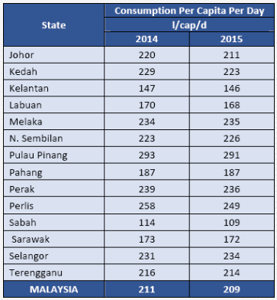
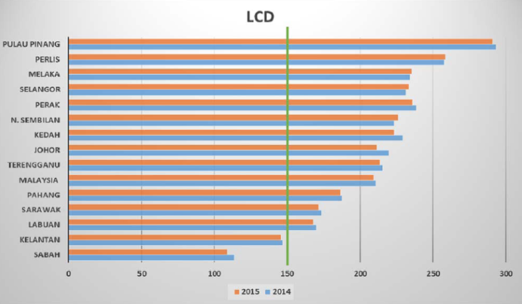
Domestic Consumption 2014-2015 Source: National Water Services Commission, 2016

Slide 9
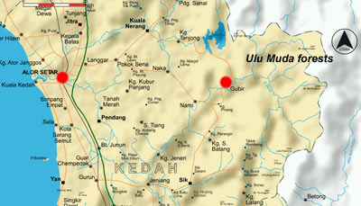
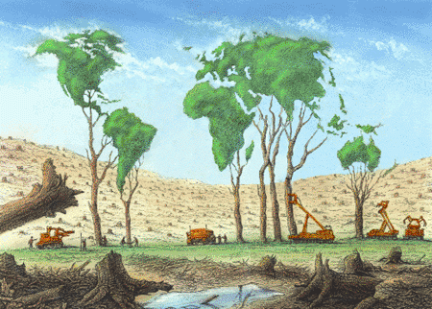

Ulu Muda, Kedah
Penang is "water-stressed";
Supply from its main source 80%: Ulu Muda catchment area.
Ulu Muda being threatened by illegal logging.

Slide 10

Forest as Sediment Filter
Sediment settles as speed of flow is reduced by forest floor;
Sediment is filtered out as sediment loaded water percolates into porous forest floor.

Slide 11
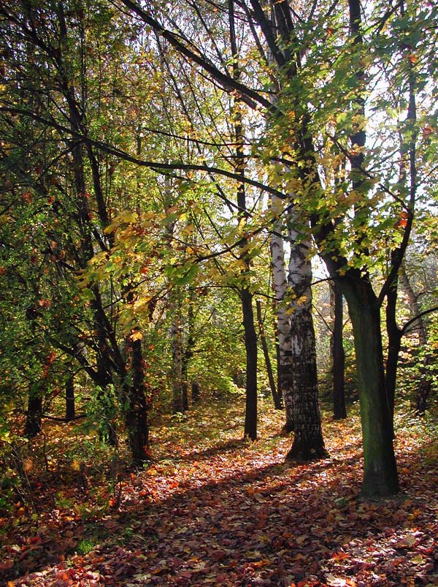
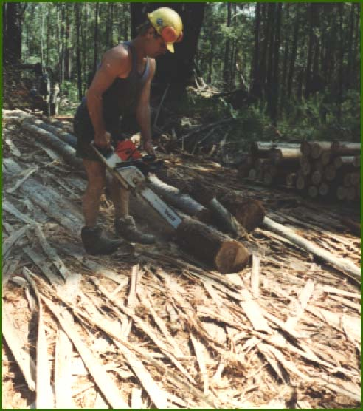
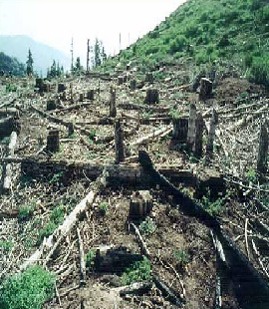
Negative Impacts of Logging

Slide 12
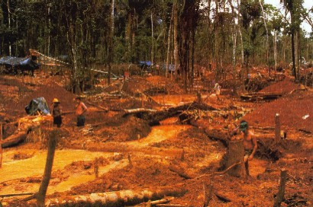
Adverse Impact of Logging

Slide 13
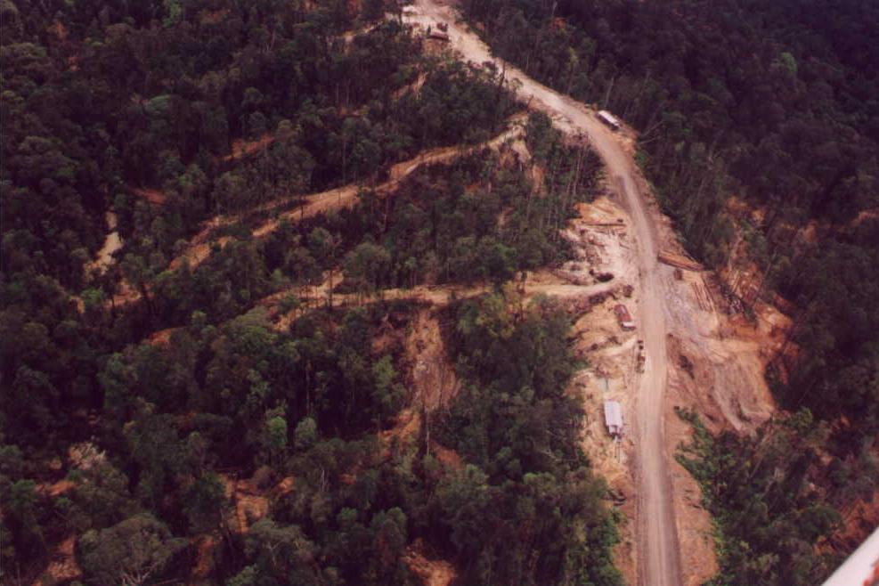
Logging roads generate large soil loss

Slide 14
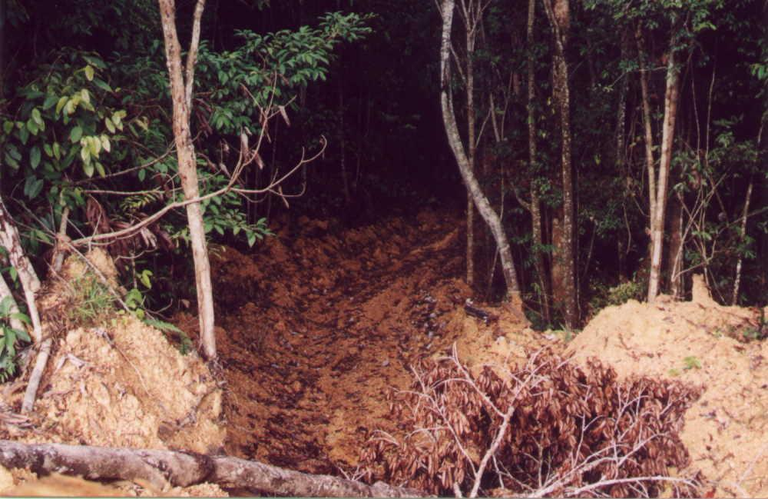
Tractor skid trail generates large soil loss

Slide 15
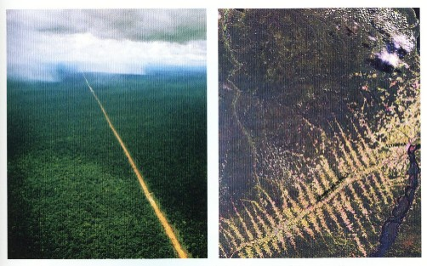
Primary Road
Consequences

Slide 16
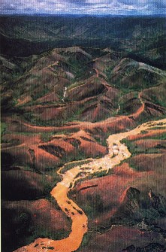
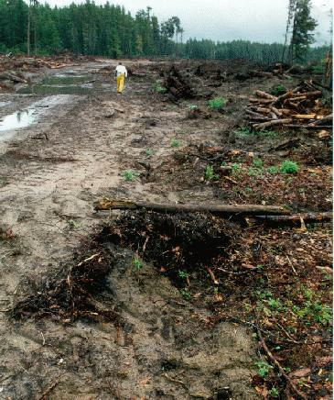
Logging causes Soil Erosion and Pollutes Rivers

Slide 17
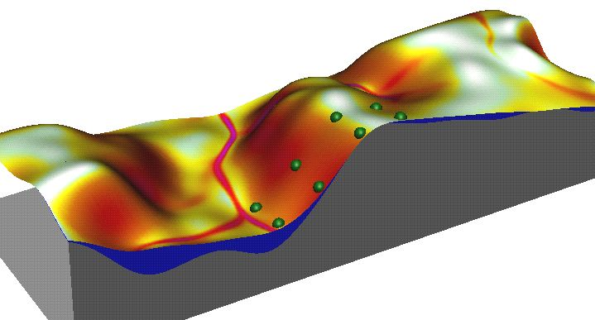
Heavy Erosion and River pollution After Logging
2. This creates
heavy soil erosion
4. Polluted water flows
into reservoir
1. Steep surfaces exposed by logging
3. Rivers are
severely polluted

Slide 18
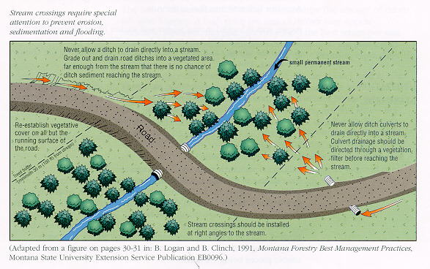
Logging Roads Pollute Rivers

Slide 19
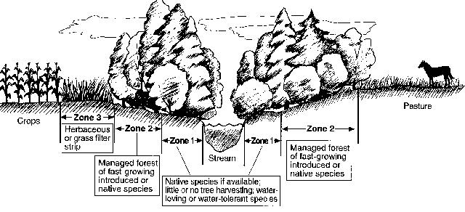
Logging destroys Riparian Buffer Zones and Pollutes streams

Slide 20
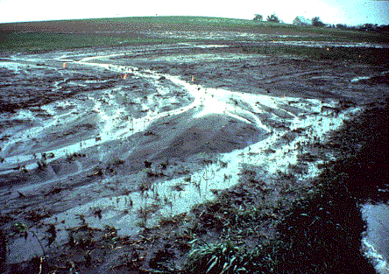
Logging intensifies runoff and generates soil loss

Slide 21
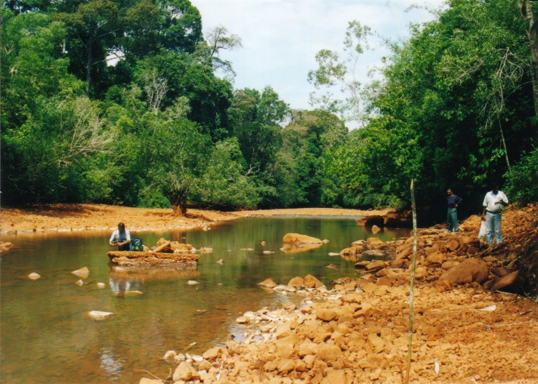
Logging Contaminates Streams

Slide 22
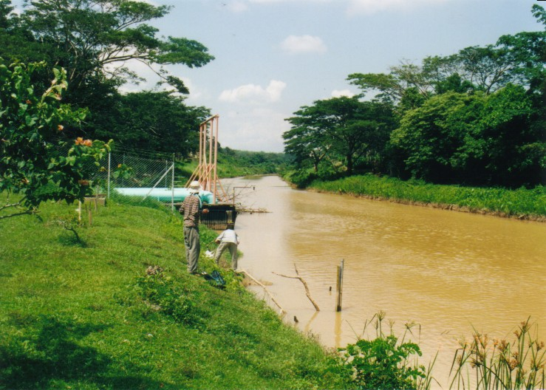
Logging Contaminates Rivers

Slide 23
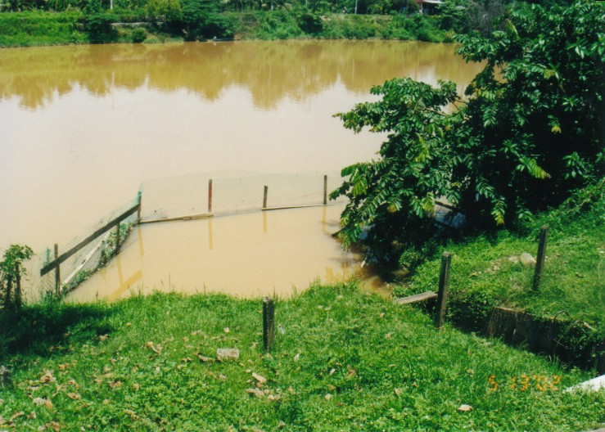
Logging Contaminates Water Supply

Slide 24
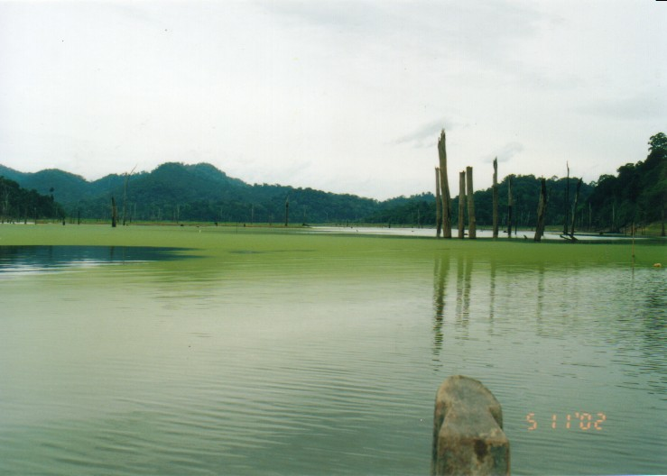
Logging Contaminates Reservoir

Slide 25
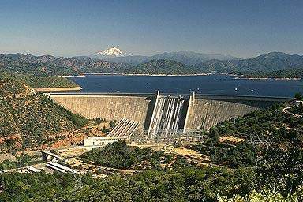
Logging Contaminates Reservoir

Slide 26
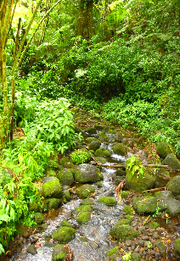
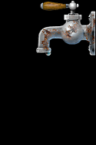
Contaminated Reservoir leads to Water Disruption

Slide 27
Portable (Drinking) Water
Water is Essential;
For how long can we endure without WATER?
1 day?
1 week?
2 weeks?
1 month?

Slide 28
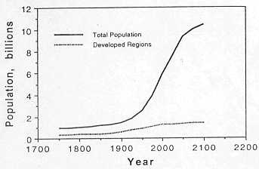
Population Growth
Carrying Capacity?
Saturation?
Saturation?

Slide 29

Use Water Wisely
Recycle;
Reuse;
Reduce;
Reserve Forests;

Slide 30
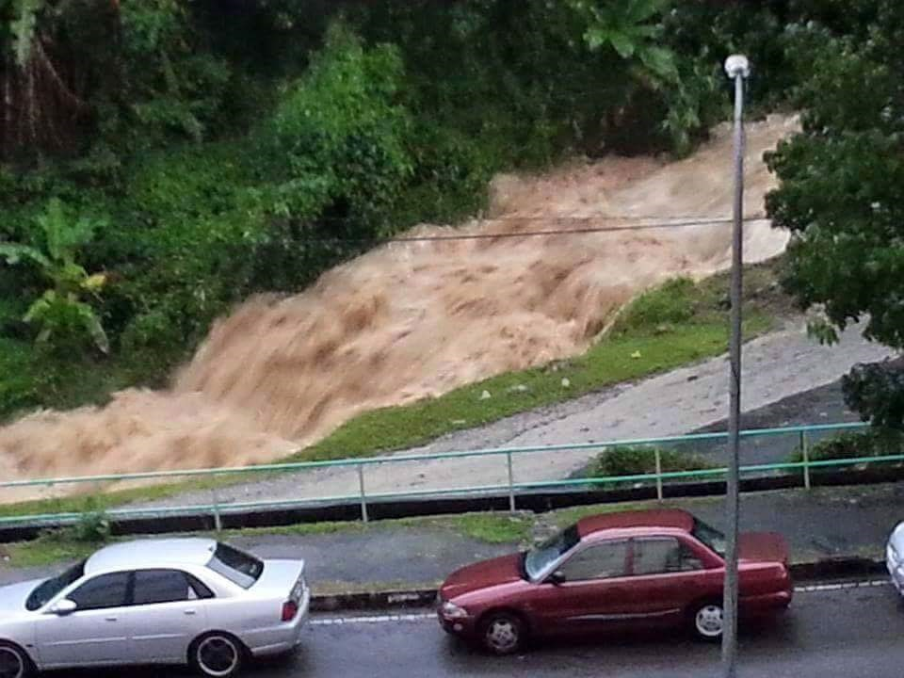
Paya Terubong (2015)

Slide 31
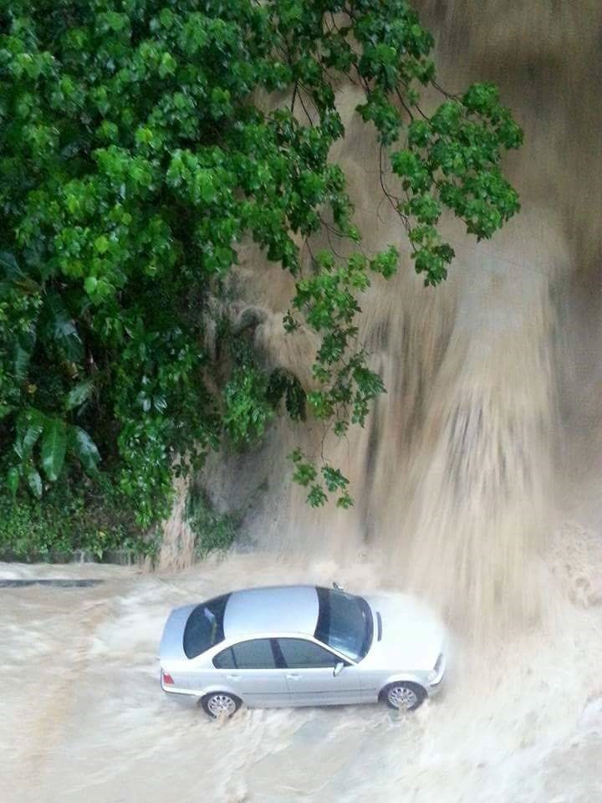

Slide 32
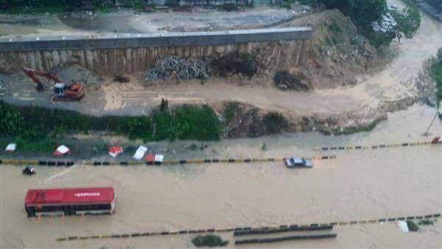

Slide 33
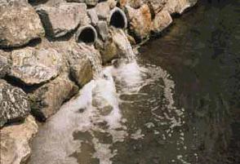
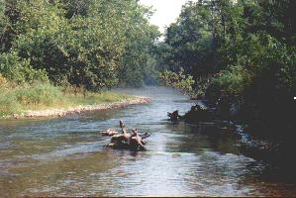
2.1 Water Quality Modeling
Water resources are polluted by effluent from industry, housing estates and others;
↓ WQ hinders recreational use and disrupts aquatic ecological balance.
Effluents discharge
Impact on Receiving Water

Slide 34
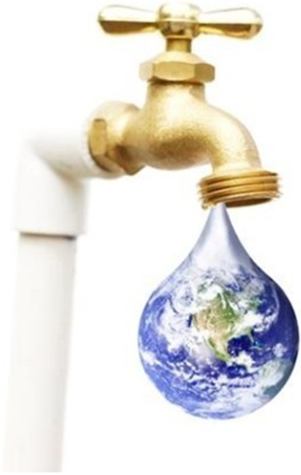
2.1 Water Quality Modeling
∴ To help preserve quality of water resources, following steps have to be taken seriously.
Determine WQ criteria for each use.
Determine WQ standards. (enforced legally to limit effluent release by industry, municipal, housing,etc)
Determine if the release of standard-abiding effluent will affect use of water according to classification in that area.

Slide 35
2.1 Water Quality Modeling
Math models - to determine the concentration of dissolved substances in water bodies so that the pollution level can be predicted;
Predicted water quality for mitigation measures planning;
Focus on modelling WQ of lakes and rivers.

Slide 36
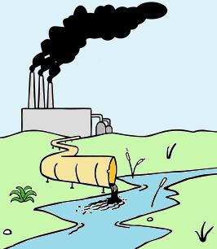
2.2 Reaction Kinetics
A number of things can happen to a pollutant once it enters a water body;
Some of these are related to transport;
Pollutant might be changed via chemical and biochemical reactions;
Kinetics or rate of such reactions can be expressed quantitatively by law of mass action:
Kinetic rate is proportional to the concentration of the reactants

Slide 37
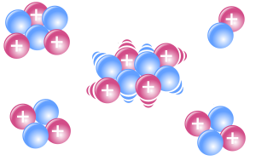
2.2 Reaction Kinetics
In this section, we focus on a single reactant, of which the reaction rate is given as
where c = concentration of the single reactant, n = order, t = time and k = kinetic rate;
The most commonly employed reactions are those of zero-, first- and second-order.

Slide 38
2.3 Zero-order Reaction
For a zero-order model, the eqn to integrate is
The equation can be integrated by separation of variables to yield
Specifies constant rate of depletion per unit time.

Slide 39
2.3 Zero-order Reaction
Thus, if a plot of concentration versus time yields a straight line, we can infer that the reaction is zero-order.
Figure 2.1 Plot of concentration vs. time for a zero-order reaction

Slide 40
2.4 First-order Reaction
For a first-order model, the eqn to integrate is
The equation can be integrated by separation of variables to yield
Specifies an exponential depletion.

Slide 41
2.3 First-order Reaction
Thus, the concentration curve asymptotically approaches zero with time.
Figure 2.2 Plot of concentration vs. time for a first-order reaction

Slide 42
2.5 Water Quality in Lake
Formulation of differential equations that describe a pollutant reaction in a lake system;
Several lake systems are considered here with various flow characteristics;
Lake models described here represent the simplest, most ideal mixing conditions;
May be quite useful in checking more complicated numerical results;
And in gaining insight to the dynamics of chemical movement in the environment.

Slide 43
How Complex Should Final Computational Model Be?
Proper model complexity is driven by:
Complexity of the environmental system.
Complexity of the pollutants of concern.
Management questions and related need for accuracy.

Slide 44
How Complex Should Final Computational Model Be?
Consequences for overly simple model:
Miss key processes and extrapolate inaccurately.
May not address relevant management questions.
May not be defensible to adversarial review.
Insufficiently adaptable to changing management requirements.

Slide 45
How Complex Should Final Computational Model Be?
Consequences for overly complex model:
Adds unnecessary data collection and computational burdens.
Adds to uncertainty.
Shifts focus away from problem solutions to endless analysis.

Slide 46
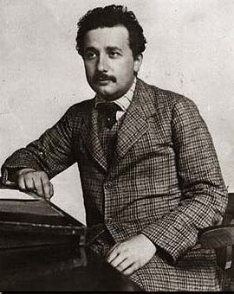
How Complex Should Final Computational Model Be?
“Make things as simple as possible,
but not any simpler.”
Albert Einstein

Slide 47
2.5 Water Quality in Lake
Major assumptions :
Chemical concentration is uniform (completely mixed);
Lake outlet has a concentration similar to the in-lake concentration C.
Real world: volume V, inflow Q_{in}, outflow Q_{out} and inflow concentration C_{in} can be time-dependent variables.

Slide 48
2.5 Water Quality in Lake
For the convenience of the discussion;
In addition to completely mixed assumption;
Following assumptions are also made:
Inflow concentration C_{in} is constant;
Volumetric flow rate into and out of the lake is constant (Q_{in} = Q_{out} = Q = constant) and lake volume is constant (dV/dt = 0);
Rate of change in concentration is governed by a first-order reaction (dC/dt = −kC).

Slide 49
Some Related Terms
Dynamic – flows change over time;
Steady State – flows do not change over time; the system is in equilibrium;
Conservative pollutants – the pollutant does not change form over time; no reactions;
Non-conservative pollutant – the pollutant changes form over time due to chemical, physical, or biological reactions.

Slide 50
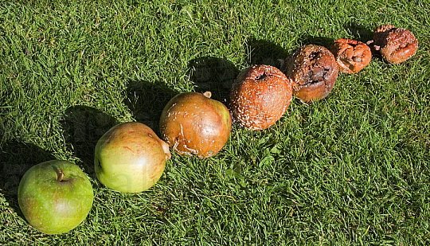
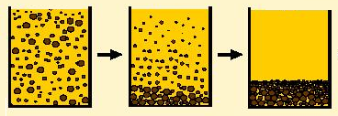
Some Related Terms
Decay – substance reduced in mass due to decomposition or sedimentation;
Sedimentation – Settlement of suspended particles.

Slide 51
2.5.1 Stagnant Lake
Consider a small lake with water volume of V m³ and initial chemical conc C(0) = C₀ kg/m³;
Chemical in lake decays at the rate of γ s⁻¹;
Chemical conc is uniform throughout the lake.
Figure 2.3 A small uniformly-mixed lake

Slide 52
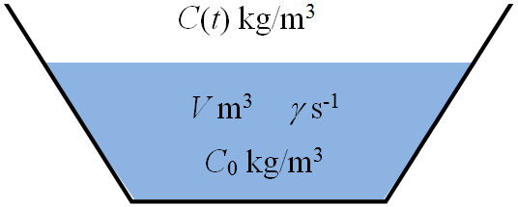
2.5.1 Stagnant Lake
Lake content = uniformly mixed;
⇒ lake = single segment;
By considering the mass balance in a short time step Δt;
Following equation (in kg) is obtained.
Constant volume

Slide 53
2.5.1 Stagnant Lake
Lake content = uniformly mixed;
⇒ lake = single segment;
By considering the mass balance in a short time step Δt;
Following equation (in kg) is obtained.
Describe chemical’s decay process
γ = reaction rate;
C = conc. at time t
V = volume of system modeled

Slide 54
2.5.1 Stagnant Lake
Let Δt → 0, differential equation for C is
A first-order reaction model;
Solving this DE by separation of variables with IC C(0) = C₀ yield the solution
(2.1)

Slide 55
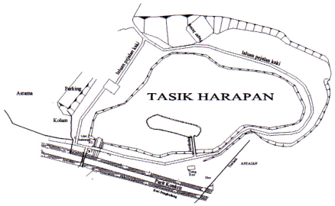
Example 2.1
Consider Lake Harapan in USM with a surface area of 10000 m² and a mean depth of 1 m. This small lake has a uniformly mixed content containing 80000 g of pollutant that decays at the rate of 0.5 d⁻¹. The concentration of the pollutant in the lake at time t is denoted by C(t).
Form and solve the differential equation for C(t) in mg/L.
Sketch the graph of C(t) when t → ∞.

Slide 56
Example 2.1(a) – Solution
Form & solve differential equation for C(t) in mg/L.
The change in concentration in the lake with respect to time t is given by the following differential equation.
Solving the differential equation yield C(t) = C₀e ^{-γt}.
Given that
and γ = 0.5 d⁻¹, we obtain

Slide 57
Example 2.1(b) – Solution
Sketch the graph of C(t) when t → ∞.

Slide 58
2.5.2 Flowing Lake
Consider a small lake with V m³ of water and initial chemical conc C(0) = C₀ kg/m³;
Water flows in and out at same rate of Q m³/s;
Inflow contains C_{in} kg/m³ of chemical;
Chemical decays at the rate of γ s⁻¹;
Chemical conc uniform in the lake.

Slide 59
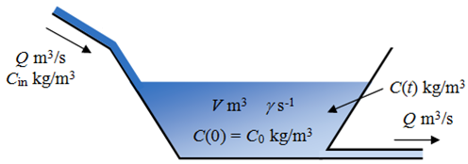
2.5.2 Flowing Lake
By considering mass balance in a short time step Δt, following equation (in kg) is obtained,
Mass input via inflow
Mass output via outflow
Mass output via decay

Slide 60
2.5.2 Flowing Lake
Let Δt → 0, then the DE for C is
(2.2)
with

Slide 61
2.5.2 Flowing Lake
Rewriting the first-order linear differential equation (2.2), we obtain
Solve by integrating factor yield
Substitution gives us k₂ = β/α ;
From the IC C(0) = C₀, k₁ = C₀ − β/α .

Slide 62
2.5.2 Flowing Lake
∴ Solution is
(2.3)
Observe that when t → ∞, e^{-αt} → 0, such that C → β/α;
Meaning when t → ∞, C(t) approaches β/α kgm⁻³.

Slide 63
2.5.2 Flowing Lake
Figure 2.5 Graph for of Equation (2.3) when (i) C₀ > β/α and (ii) C₀ < β/α

Slide 64

2.5.3 Flowing Lake with Loading
Similar lake: V m³ and C(0) = C₀ kg/m³;
Inflow: Q m³/s with C_{in} kg/m³ of chemical;
Nearby factory releases chemical at μ kg/s;
Kinetic decay γ s⁻¹.

Slide 65
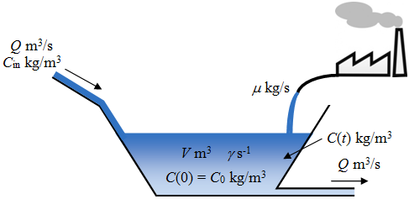
2.5.3 Flowing Lake with Loading
Mass source:
Mass sink:
Mass balance in a short time step Δt:

Slide 66
2.5.3 Flowing Lake with Loading
Let Δt → 0, then the DE for C is
(2.4)

Slide 67
2.5.3 Flowing Lake with Loading
Rewriting the first-order linear DE (2.4):
∴ The solution is
(2.5)

Slide 68
2.5.4 Flowing Lake with Loading and Sedimentation
Similar lake; Wastewater Inflow
Catchment area wastewater at μ kg/s;
Kinetic decay γ s⁻¹;
Surface area A_{s} m².
Sedimentation vel. v m/s;

Slide 69
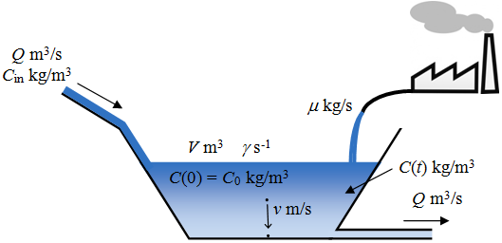
2.5.4 Flowing Lake with Loading and Sedimentation
Mass source:
Mass sink:
Mass balance in a short time step Δt:

Slide 70
2.5.4 Flowing Lake with Loading and Sedimentation
Let Δt → 0, then the DE for C is
(2.6)

Slide 71
2.5.4 Flowing Lake with Loading and Sedimentation
Rewriting the first-order linear DE (2.6):
∴ The solution is
(2.7)

Slide 72
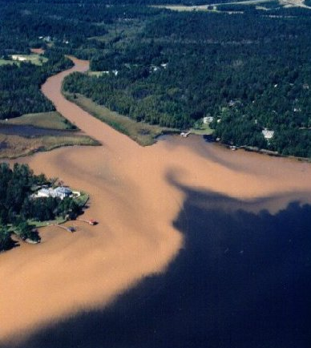
Lake Model – Summary
Stagnant Lake
with Loading
Flowing
& Sedimentation:

Slide 73
2.5.5 Simple Model at Steady-state
Mass
loading
Mass loss by
sedimentation
Mass loading
by inflow
Mass loss
by outflow
Mass loss
by decay
(2.8)

Slide 74
2.5.5 Simple Model at Steady-state
Here,
C = concentration, kg/m³;
t = time, s; μ = loading, kg/s;
C_{in} = inflow concentration, kg/m³;
Q_{in} = inflow, m³/s;
Q_{out} = outflow, m³/s;
γ = decay rate, s⁻¹;
V = volume, m³;
A_{s} = surface area, m²;
v = settling velocity, m/s.

Slide 75
2.5.5 Simple Model at Steady-state
If the system is subject to a constant loading μ for a sufficient time;
It will attain a dynamic equilibrium condition called steady-state;
In mathematical terms this means that accumulation is zero, that is

Slide 76
2.5.5 Simple Model at Steady-state

Slide 77
2.5.5 Simple Model at Steady-state
If dC/dt = 0 and Q = Q_{in} = Q_{out} , concentration at steady state is
(2.9)
(2.10)

Slide 78
2.5.5 Simple Model at Steady-state
C = f (μ, physics, chemistry, biology)
LOADING
The rate of pollutant
discharge
CONCENTRATION
How polluted
the system is
ASSIMILATION FACTOR
How physics, chemistry and biology convert the loading rate into concentration

Slide 79
2.5.5 Simple Model at Steady-state
The number a = Q + γV + vA_{s} with unit m³/s is called the assimilation factor;
If the function consists of QC_{in} only, i.e. μ = 0,
then

Slide 80
2.5.5 Simple Model at Steady-state
Ratio reflects treatment level achieved after wastewater flowed thru the lake;
∴ the term
is coined treatment factor (transfer coefficient).

Slide 81

Treatment Pond

Slide 82
2.5.5 Simple Model at Steady-state
Treatment level achieved after wastewater flowed thru the lake.
90 % of the waste from inflow have been eliminated
10 % of waste are left in the water that flows out of the lake
C/C_{in} = 0.1

Slide 83
Treatment factor/ Transfer coefficient
(2.11)
specifies how the system input C_{in} is transformed or “transferred” to an output (as represented by C);
r is a number without any unit or dimension;
Numerator = denominator = m³/s.

Slide 84
Treatment factor/ Transfer coefficient
(2.11)
r << 1: lake’s removal mechanisms will greatly reduce lake’s pollutant level, i.e. great assimilative capacity;
r → 1: lake’s removal mechanisms are weak relative to its supply mechanism, i.e. assimilative capacity is minimal.

Slide 85
Treatment factor/ Transfer coefficient
Evaluate lake’s assimilative capacity;
Assimilation ↑ for large values of reaction rate, settling velocity, volume, and area;
Flow in both the numerator and the denominator acts to both ↑ and ↓ assimilation;
↑ assimilation = flushing of pollutant through the lake’s outlet;
↓ assimilation = delivery of pollutant via lake’s inflow.

Slide 86
Water Residence Time τ_{w}
(2.12)
amount of time required for the outflow to replace the quantity of water in the lake;
measure of the lake’s flushing rate;
Large volume + small flow = long residence time, i.e. slow flusher;
Small volume + large flow = short residence time, i.e. fast flusher.

Slide 87
Pollutant Residence Time τ_{c}
(2.13)
amount of time that the pollutant would stay or “reside” in a system;
τ_{c} is affected by reactions and settling in addition to the outflow.

Slide 88
Example 2.2
A lake has the following characteristics:
A_{s} = 4 × 10⁴ m²
(I) volume V = 10⁵ m³,
(II) surface area A_{s} = 4 × 10⁴ m² and
(III) mean depth H = 2.5 m.
H = 2.5 m
V = 10⁵ m³
A_{s} = 4 × 10⁴ m²

Slide 89

Example 2.2
Inflow and outflow are measured as Q = 10⁴ m³/h.
This lake receives waste input that does not undergo sedimentation from three sources:
(i) industrial waste at rate of 100 kg/h,
(ii) inflow with concentration 10 mg/L and
(iii) atmospheric flux J = 1 g/m²/h.
This waste decays at the rate of 0.20 h⁻¹.

Slide 90
Example 2.2
J = 1 g/m²/h
C_{in} = 10 mg/L
W = 100 kg/h
A_{s} = 4×10⁴ m²
V = 10⁵ m³
H = 2.5 m
γ = 0.20 h⁻¹
(iii) atmospheric flux J = 1 g/m²/h.
(i) industrial waste at rate of 100 kg/h,
(ii) inflow with concentration 10 mg/L

Slide 91
Example 2.2
Find the assimilation and treatment factors.
Determine the waste concentration in the lake at steady state.
Find the rate of change in mass for each process and shows the mass balance.

Slide 92
Example 2.2(a) – Solution
Find the assimilation and treatment factors.
The assimilation factor (Equation 2.10) is
The treatment factor (Equation 2.11) is
This means that one-third of the inflow waste concentration will flow out of the lake.
This means that one-third of the inflow waste concentration will flow out of the lake.

Slide 93
Example 2.2(b) – Solution
Determine the waste concentration in the lake at steady state.

Slide 94
Example 2.2(b) – Solution
Determine the waste concentration in the lake at steady state.

Slide 95
Example 2.2(b) – Solution
Determine the waste concentration in the lake at steady state.

Slide 96
Example 2.2(c) – Solution
Find the rate of change in mass for each process and shows the mass balance.
Rate of mass change from loading,
Rate of mass change from outflow,
Rate of mass change from kinetic decay,

Slide 97
Example 2.2(c) – Solution
Find the rate of change in mass for each process and shows the mass balance.

Slide 98
Example 2.2(c) – Solution
Find the rate of change in mass for each process and shows the mass balance.
Rate of mass change from loading,
∴ Total rate of change in mass 80+160 = 240 kgh⁻¹ balances the total mass input 240 kgh⁻¹
Rate of mass change from outflow,
Rate of mass change from kinetic decay,

Slide 99

Thank You

